Slide 1

Whole Brain Living
The Four Characters of a Woman’s Brain

Slide 2
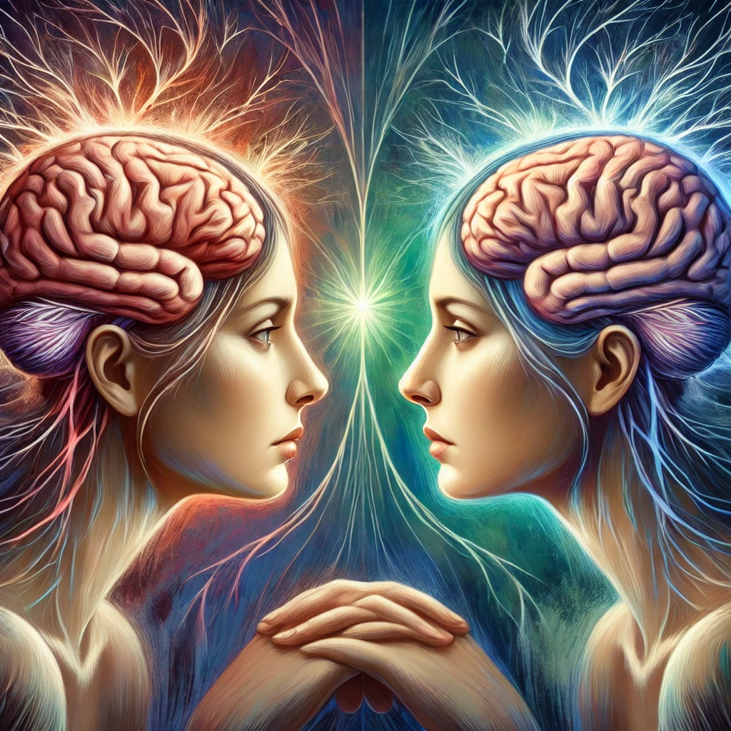
FOUR PARTS OF OUR BRAIN
RIGHT THINKING
Character 4
RIGHT
LEFT
LEFT THINKING
Character 1
RIGHT FEELING
Character 3
LEFT FEELING
Character 2

Slide 3




Character 4
OUR FOUR CHARACTERS
Character 1
RIGHT
LEFT
Character 3
Character 2

Slide 4
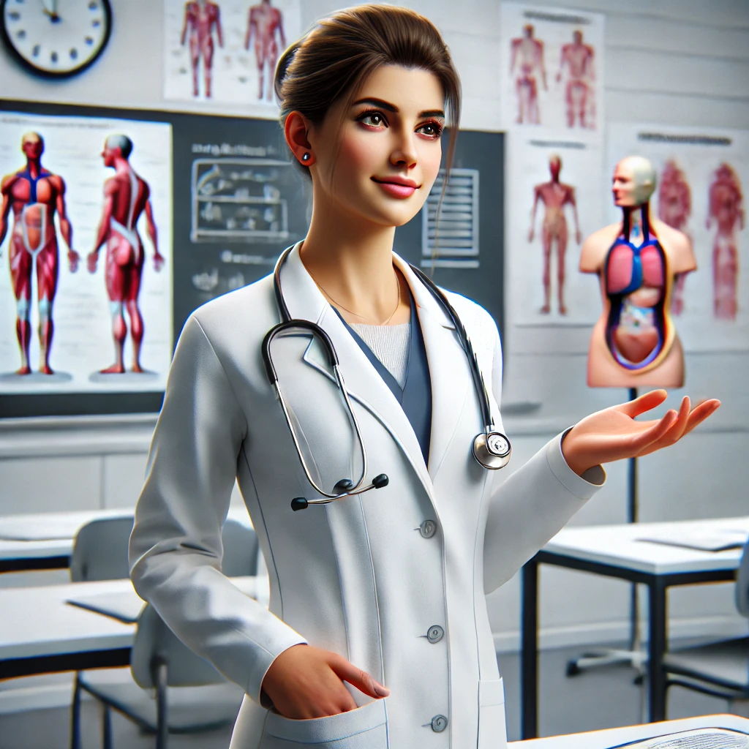

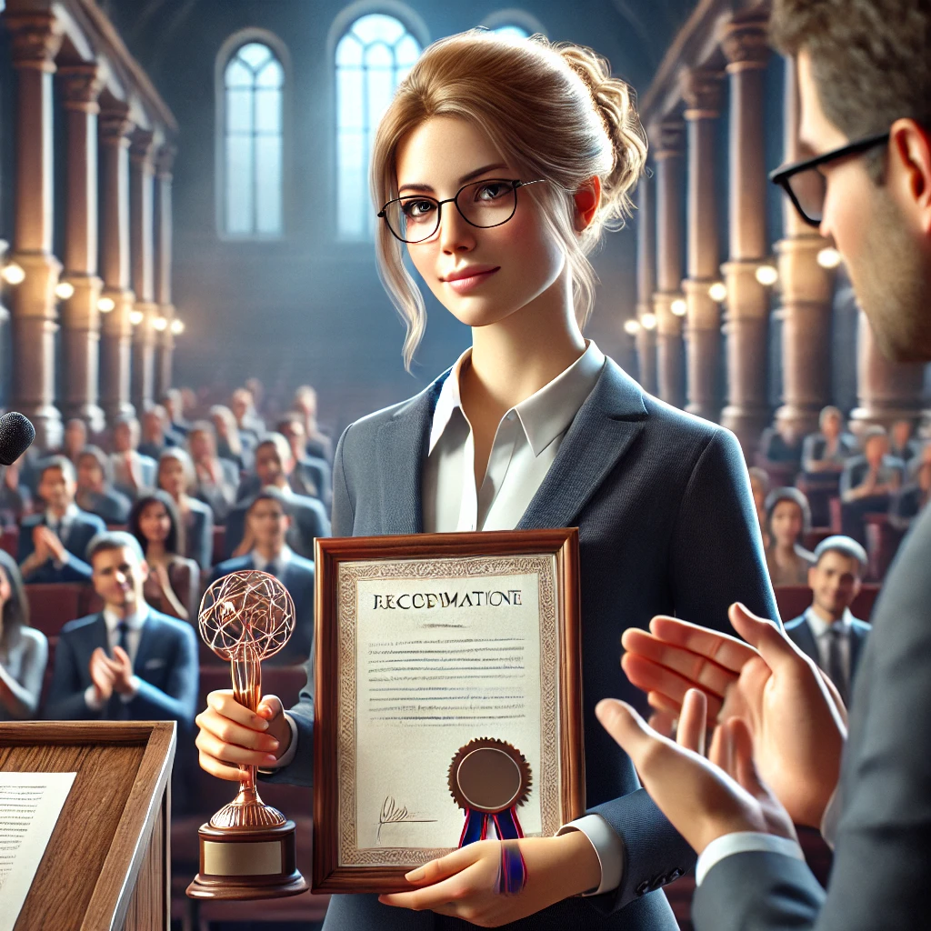
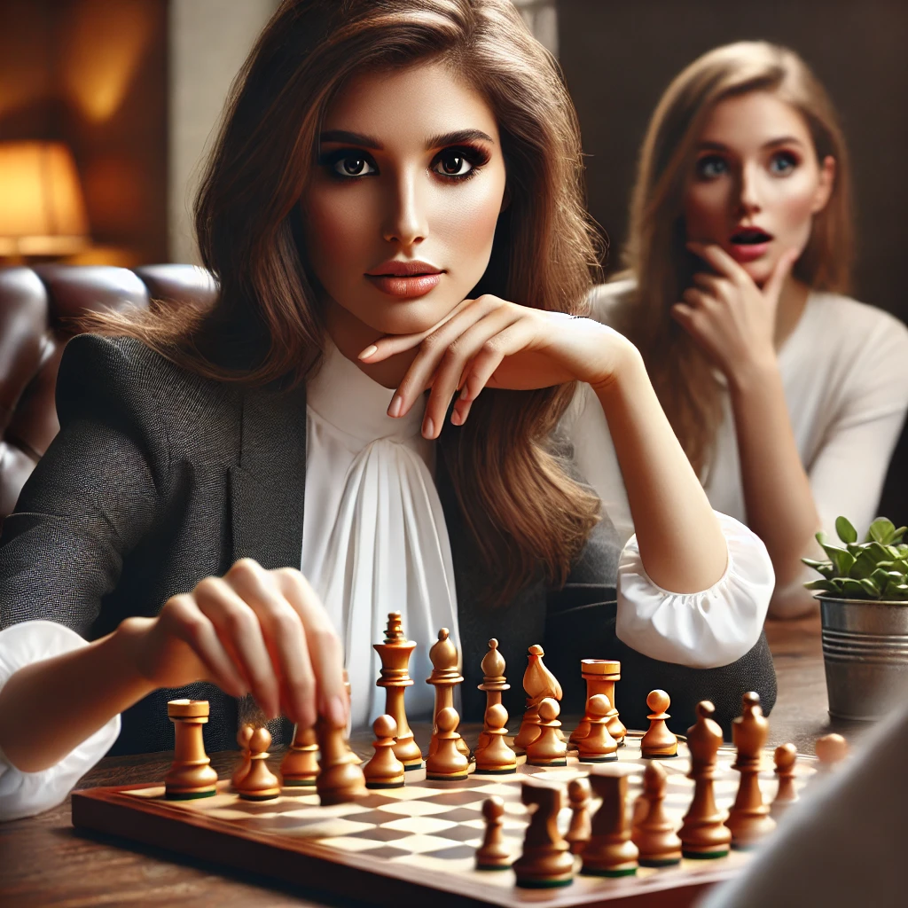
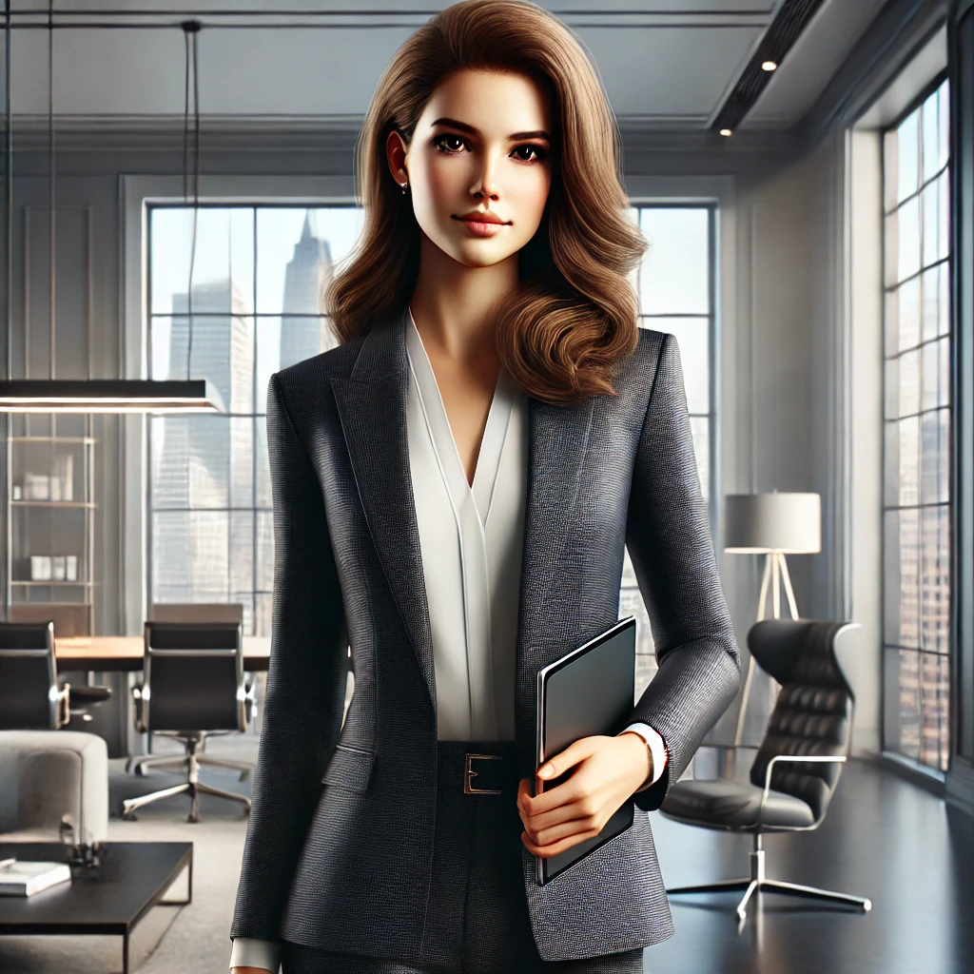
Character 1
Helpful
Orderly
Clean
Careful
Studious
Attentive
Neat
Respectful
Fixes things
Judges

Slide 5
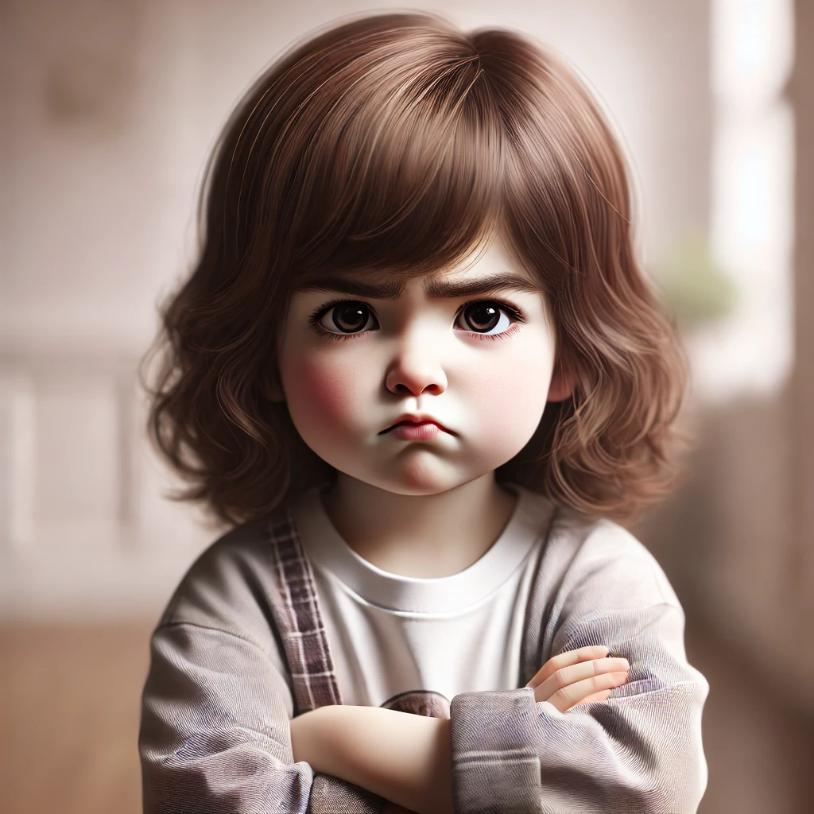
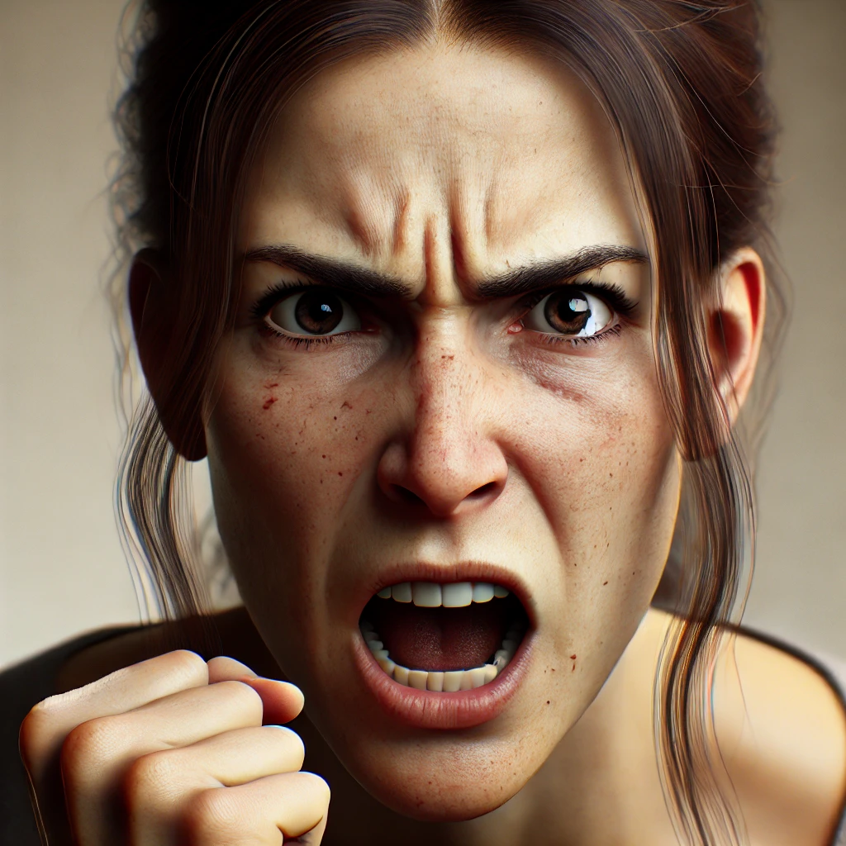
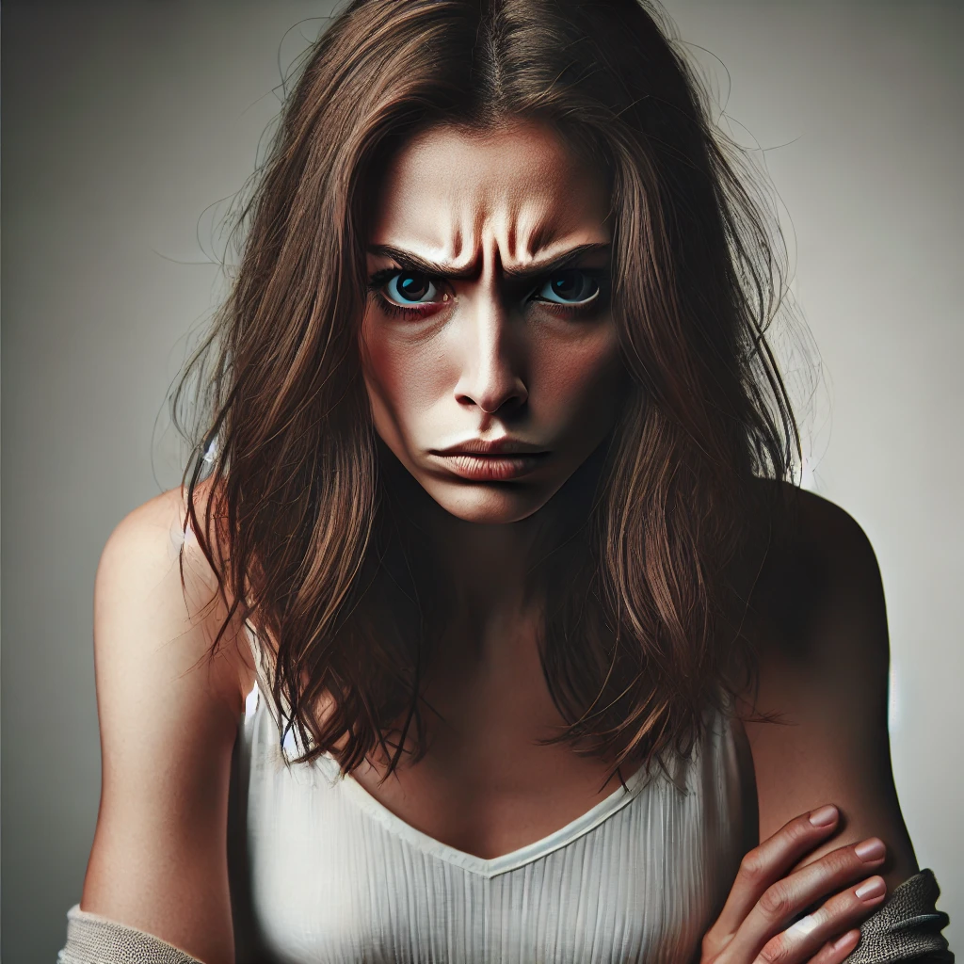
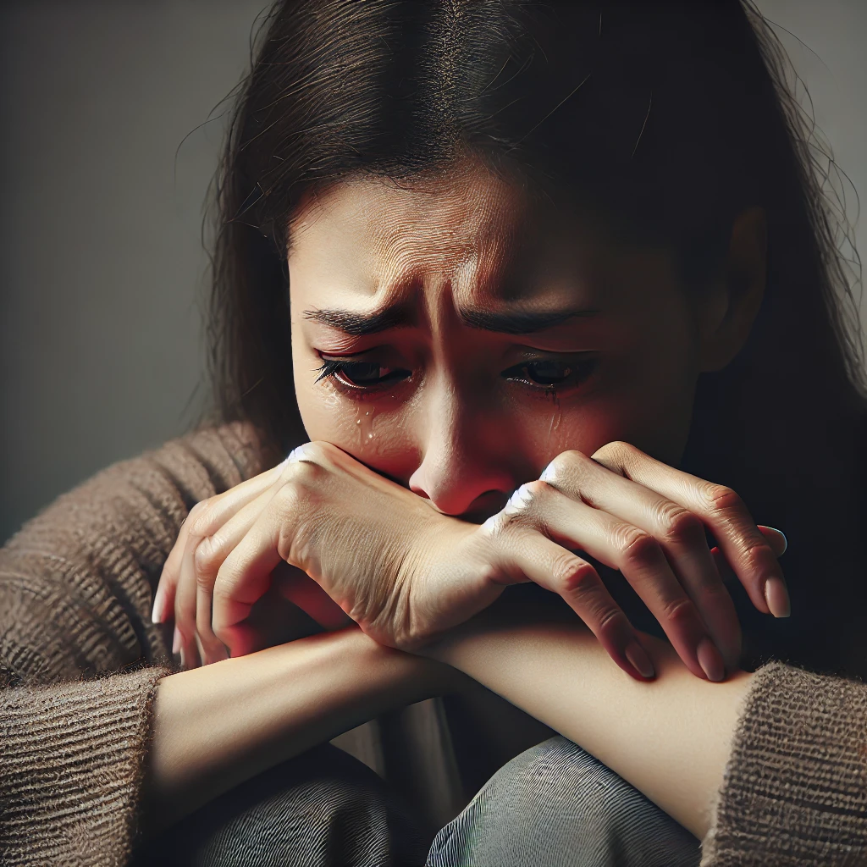
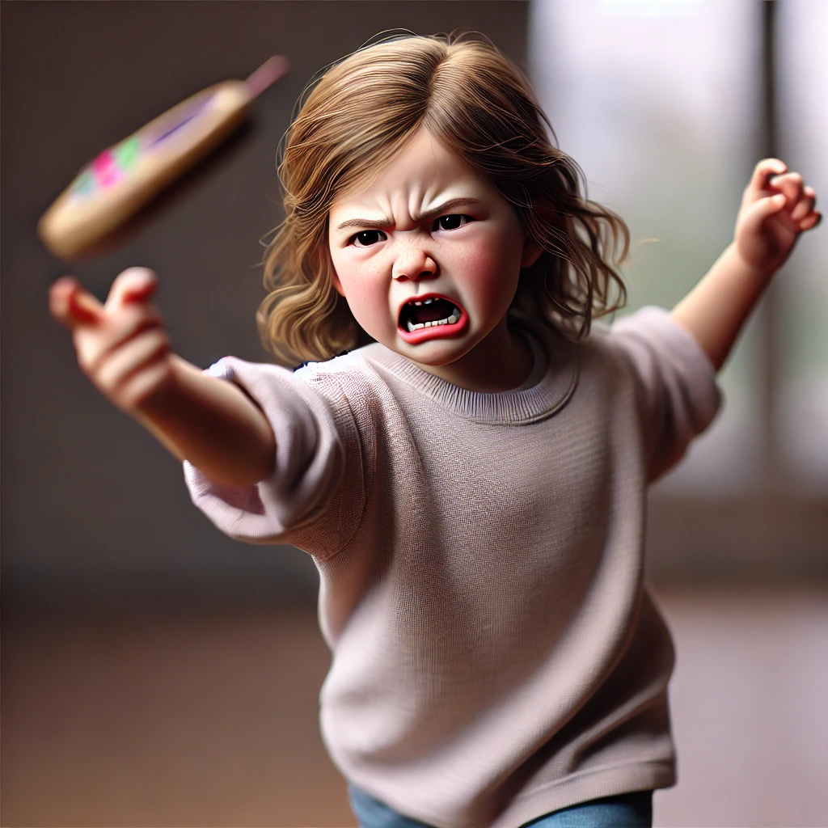
Character 2
Sad
Mad
Unhappy
Anxious
Scared
Complains
Worries
Fights
Fearful
Dishonest

Slide 6




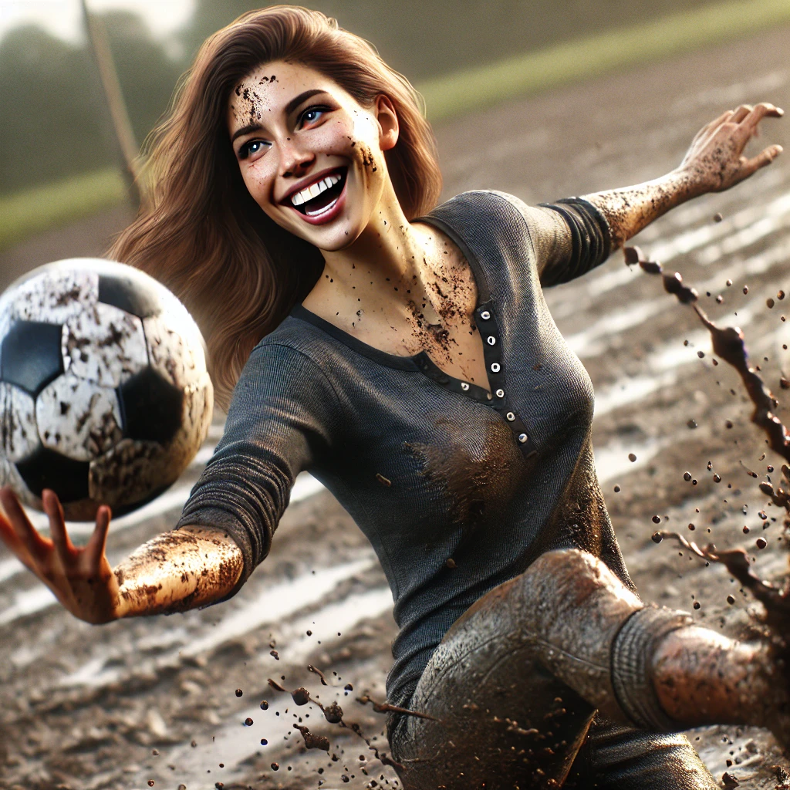
Character 3
Playful
Joyful
Creative
Innovative
Musical
Adventurous
Artistic
Curious
Enthusiastic
Youthful

Slide 7


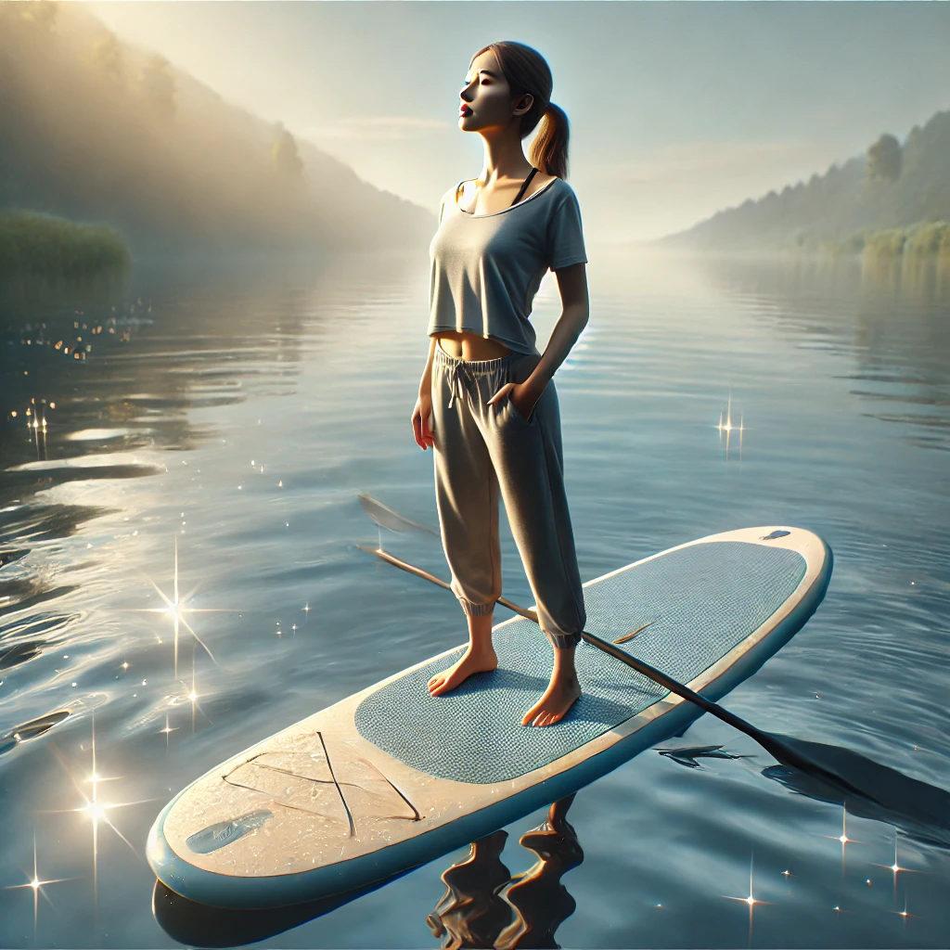

Character 4
Peaceful
Calm
Loving
Gentle
Grateful
Sharing
Kind
Helpful
Generous
Magical

Slide 8
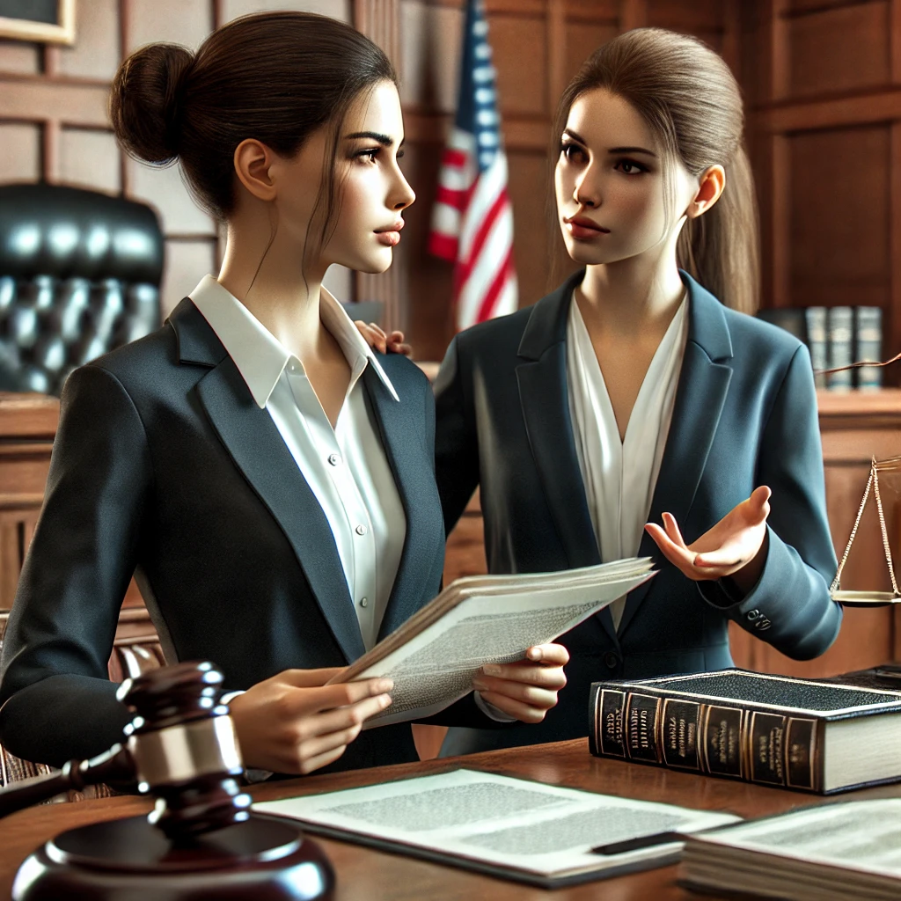
Two Character 1s learning together
Character 1
Character 1

Slide 9
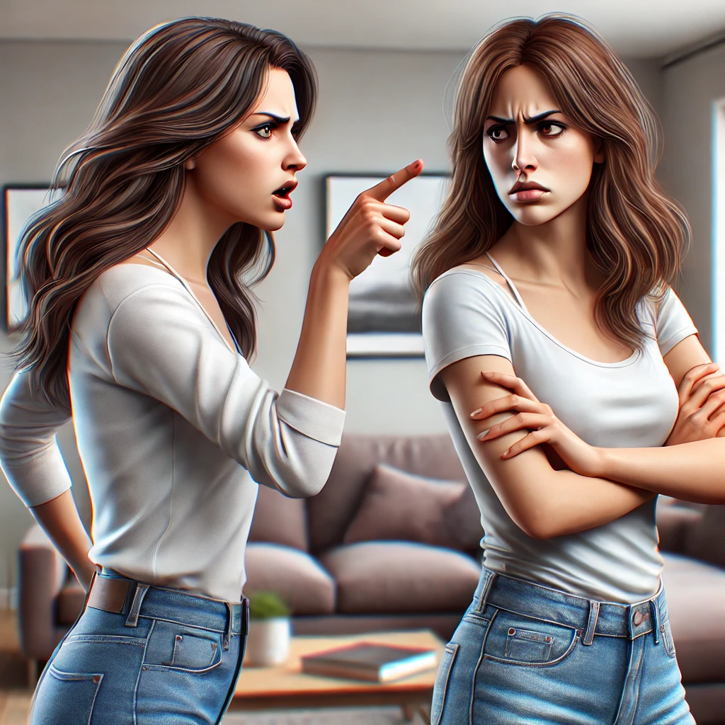
Two Character 2s will never find peace
Character 2
Character 2

Slide 10

Two Character 3s are looking for excitement!
Character 3
Character 3

Slide 11
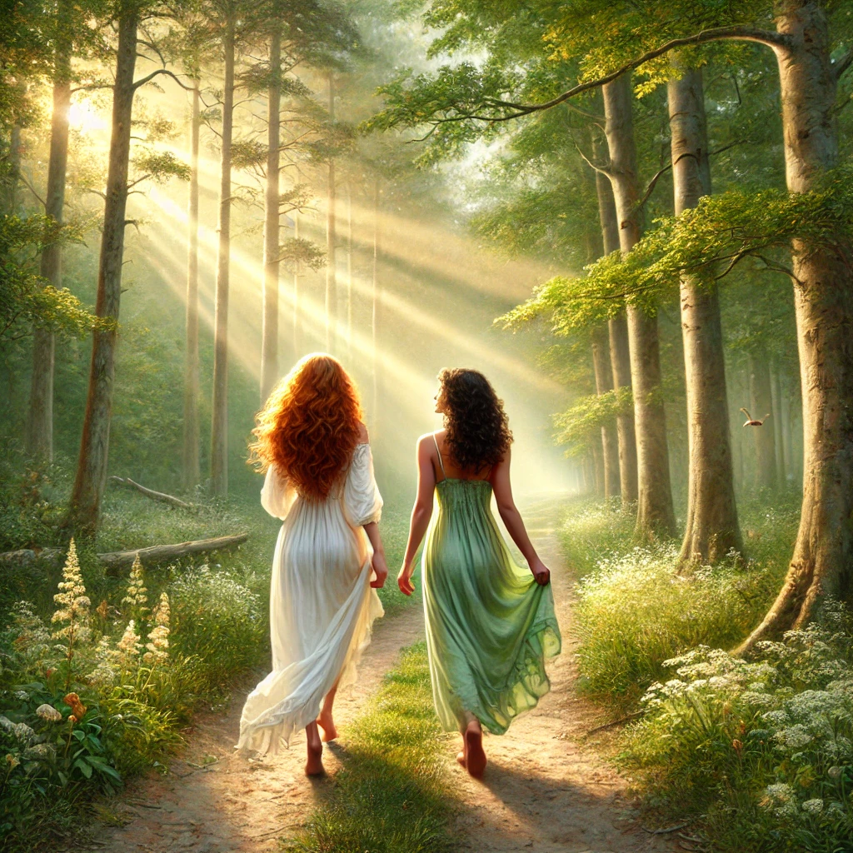
Two Character 4s enjoying a peaceful moment
Character 4
Character 4

Slide 12
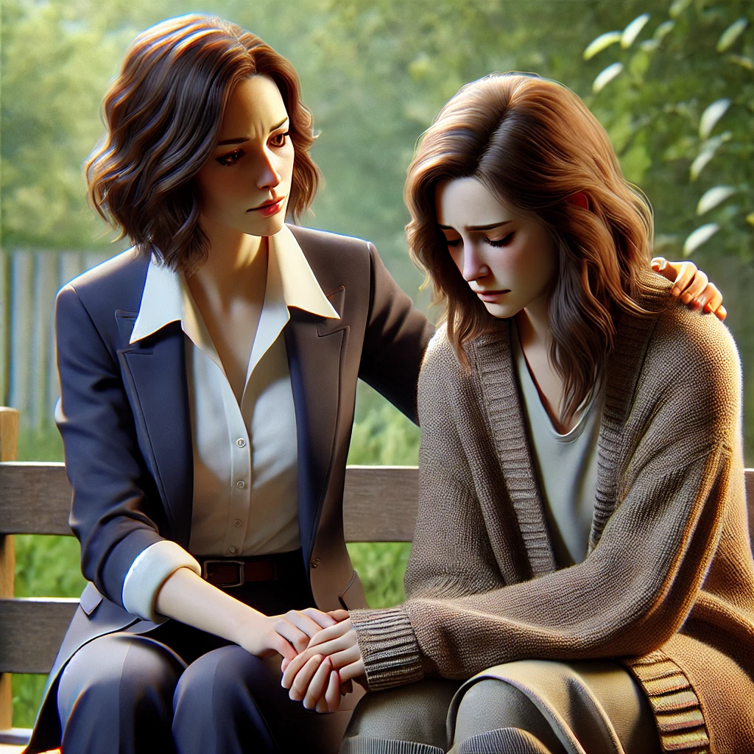
Character 1 wanting to fix something for Character 2
Character 1
Character 2

Slide 13
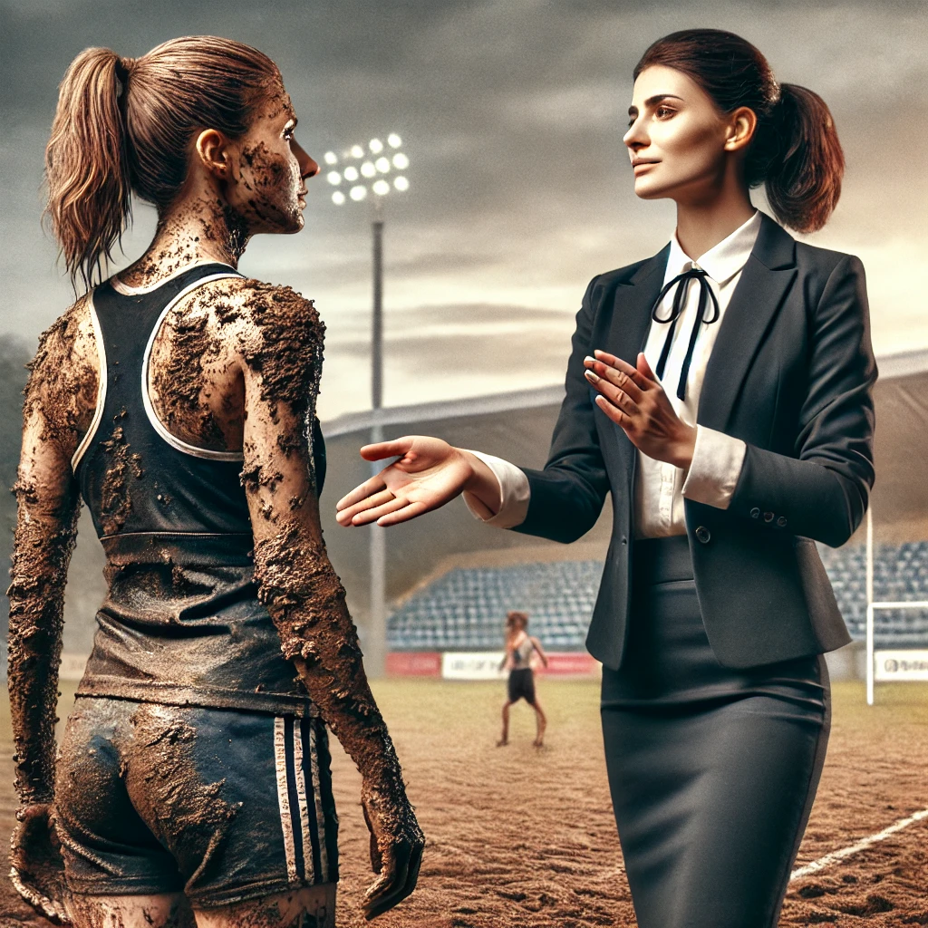
Character 1 appreciating a happy and healthy Character 3
Character 1
Character 3

Slide 14
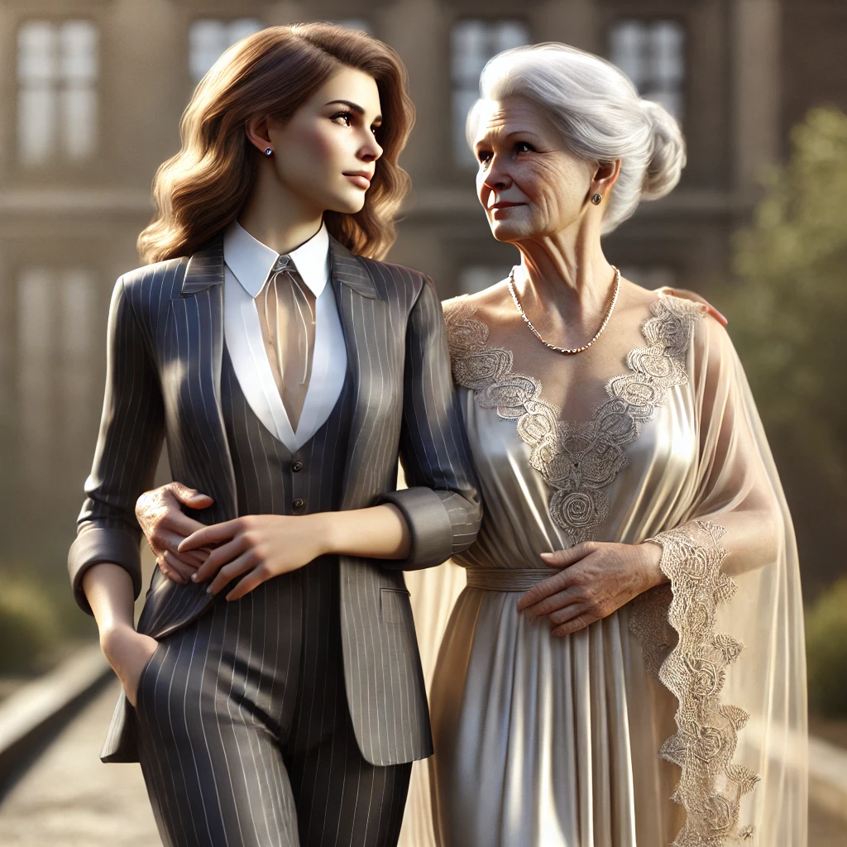
Character 1 and Character 4 lovingly supporting one another
Character 1
Character 4

Slide 15

Character 3 trying to include Character 2 in the fun
Character 3
Character 2

Slide 16
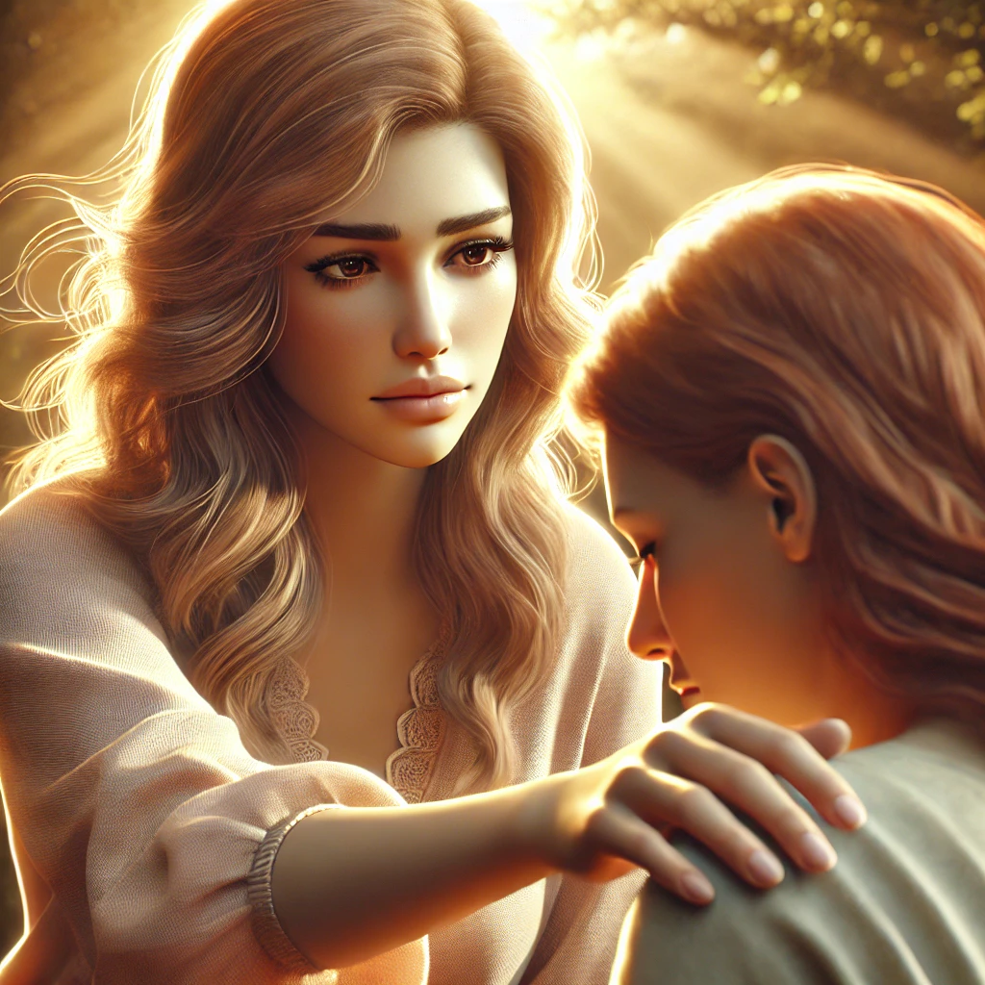
Character 4 lovingly supporting Character 2
Character 4
Character 2

Slide 17
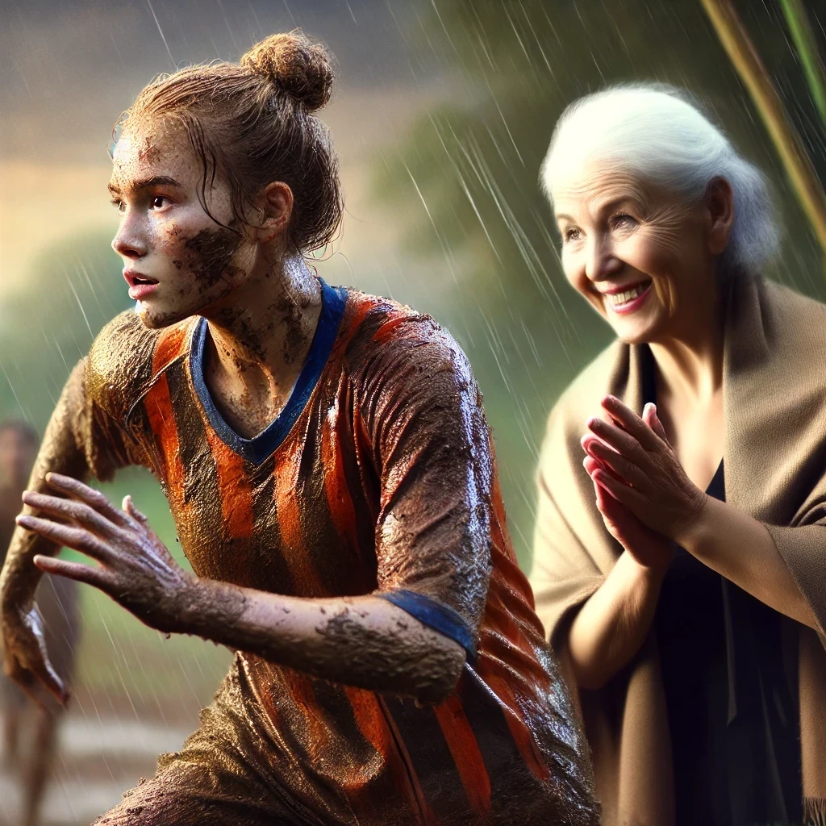
Character 4 cheering on Character 3
Character 4
Character 3

Slide 18
OUR FOUR CHARACTERS
Character 4
Character 1
Character 3
OUR BRAIN’S TEAM
Character 2

